Slide 1
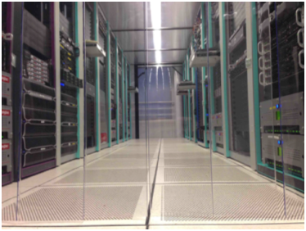
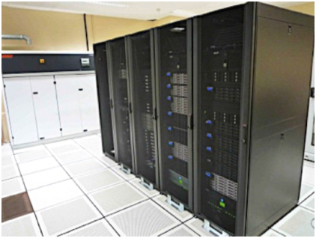
Module 1
Infrastructure
CICLAD cluster at UPMC (Jussieu)
ClimServ at Polytechnique (Palaiseau)

Slide 2
Mesocentre description
Mesocentre ESPRI / IPSL
Computing resources closest to the data storage
Distributed on several sites (UPMC and Ecole Polytechnique)
https://mesocentre.ipsl.fr
Description Items
Computing Units
Storage and File System
Networks
Disk spaces
Data distribution services / Projects hosting

Slide 3
Mesocentre description
Computing units
Interactive / Head Nodes:
SSH connection to the Mesocentre
Dedicated to calculations and short or interactive processes:
Program developments
Visualisation of results
Short processing requiring interaction:
➔ Entering input values
➔ Follow-up of results
Shared resources (CPU, Memory)
Limited resources
1 h CPU max — 4Go RAM/user
Registered on national computing centres (access allowed from these nodes)
# Login on ClimServ
# camelot
# AMD 16-core 2.5GHz | 64Gb
> ssh login@camelot.ipsl.polytechnique.fr
# loholt1/2
# Intel 16-core 2.4GHz | 64Gb
> ssh login@loholt1.ipsl.polytechnique.fr
> ssh login@loholt2.ipsl.polytechnique.fr
# Login on CICLAD
# ciclad
# AMD 32-core 3.0GHz | 132Gb
> ssh login@ciclad.ipsl.jussieu.fr
# ciclad2
# Intel 16-core 2.4GHz | 64Gb
> ssh login@login@ciclad2.ipsl.jussieu.fr

Slide 4
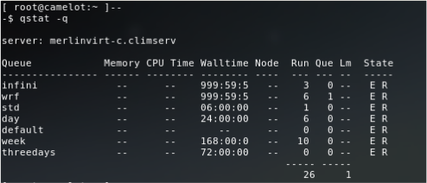
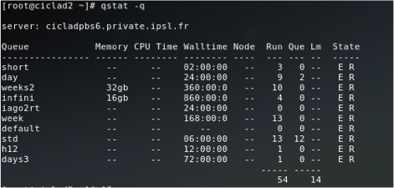
Mesocentre description
Computing units
High Performance Computing Clusters
Accessible via the Head Nodes: qsub command
50 computing nodes (2400 AMD cores)
32 or 64 core per node (4 sockets)
Memory: 4Gb/core (up to 256 GB per node)
Dedicated to any calculations or processes (short, long, interactive, non-interactive, etc.)
Managed by a Queueing / Resource manager system (Torque / Maui)
Per job/process reserved resources (dedicated CPUs)
PBS Queues on ClimServ
PBS Queues on Ciclad

Slide 5
Mesocentre description
Computing units
Processors Architecture AMD / Intel
What Wikipedia teaches us on “Processor architecture”:
“All computers run using very low-level commands which do some very basic functions, such as reading data, writing data, jumping to addresses, and calculating basic arithmetic. […] Instruction sets are relatively small; most higher-order programming languages, such as C++, Ada, Fortran, or Visual Basic, must be compiled (or translated, or interpreted) into these low level commands in order for a program to run.”
Instruction sets can be extended depending on the CPU generation and version (MMX, 3DNow, SSE, PAE, etc.) List the CPU properties with: cat /proc/cpu
The extended instructions are used by the compiler when optimisation parameters are used (-fast, -O3, -O4, etc.) for the compilation
So what ?
The Mesocentre’s nodes are built upon several generation of processors
Need to use an instruction set appropriate to the computing node CPU
By default, Intel compilers does not generate processor-specific code (option -march)
By default, PGI compilers generates processor-specific code. To force code / CPU compatibility :
Instructs PGI compiler to generate a code with common instruction sets (option -tp=x64)
Instructs PGI compiler to generate a processor-specific code (e.g. -tp=piledriver) and submit the job on the appropriate node: qsub –l nodes=1:piledriver […]

Slide 6
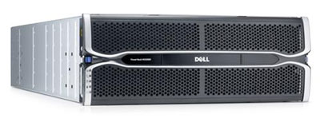
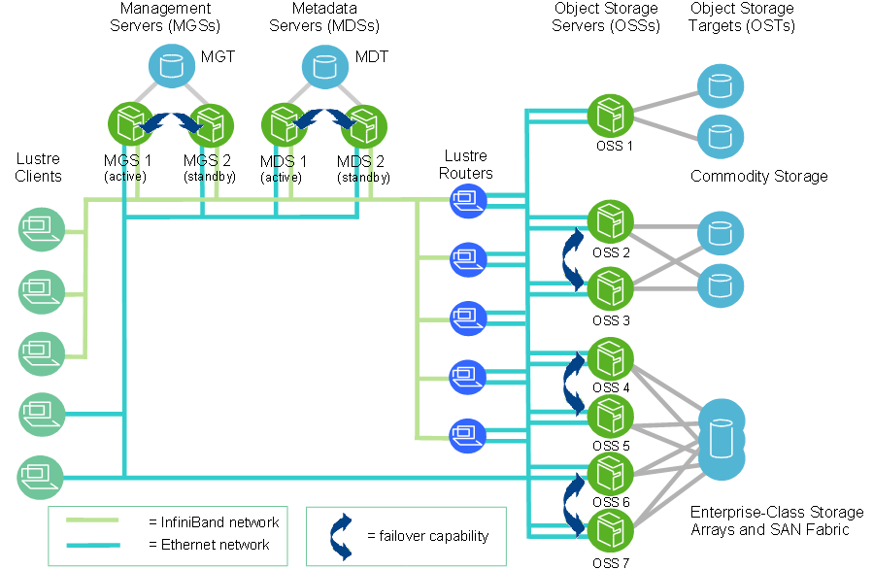
Mesocentre description
Storage and filesystem
Storage Hardware
60-Disks Redundant (RAID) Storage Arrays
8 or 16 Gbps Fibre Channel server connection
25 physical servers
More than 1300 Hard Disk
4.8 Pb of raw hard disk = 3 Pb of effective storage capacity
Storage File System
Lustre Parallel Filesystem
MetaData Servers (MDS) with MetaData Targets (MDT) store namespace metadata (filenames, directories, access permissions, and file layout)
Object Storage Server (OSS) with Object Storage Targets (OST) store file data
Clients that access and use the data.
The capacity of a Lustre FS is the sum of the capacities provided by the OSTs.

Slide 7
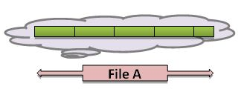
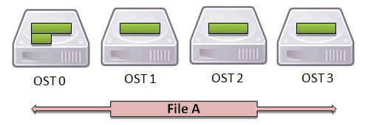
Mesocentre description
Storage and filesystem
Lustre Best practices
Reading, writing, and removing many small files burdens the file system and can slow it down for all users.
Placing too many files in a single directory negatively impacts performance.
Avoid using ls -l (or any ls command that uses the -l flag, or any command that must stat many files in quick succession).
Do not use wildcards (*) in directories containing thousands of files.
Open files read-only, specifying O_NOATIME if there is no reason to update the access time.
If many processes need the stat information from a single file, it is most efficient to have a single process perform the stat call and broadcast the results.
Avoid frequently opening files in append mode, writing small amounts of data, and closing the file.
Instead of reading a small file from every task, read the entire file from one task and broadcast the contents to all other tasks.
(https://www.rc.colorado.edu/support/examples-and-tutorials/parallel-io-on-janus-lustre.html)
File Striping
Lustre FS can distribute the segments of a single file across multiple OSTs to improve I/O performances
By default file striping is not activated system-wide: If an OST is failed the whole FS is corrupted.
File striping can be activated for a specific file or directory
(www.nics.tennessee.edu/computing-resources/file-systems/io-lustre-tips)

Slide 8
Mesocentre description
Storage and filesystem
Lustre User commands
Lustre's lfs utility provides several options for monitoring and configuring your Lustre environment
# Options of LFS command
> lfs help
> lfs help option-name
# Check disk space usage
> lfs df [-i] [-h] [--pool|-p <fsname>[.<pool>] [path]
# Check disk quotas
> lfs quota -u username /home
# Search the directory tree (more efficient than GNU find command)
> lfs find [[!] --atime|-A [-+]N] [[!] --mtime|-M [-+]N] [[!] --ctime|-C [-+]N] [--maxdepth|-D N] [--name|-n ] [—print|-p] [--print0|-P] [[!] --obd|-O ] [[!] --size|-S [+-]N[kMGTPE]] --type |-t {bcdflpsD}] [[!] --gid|-g|--group|-G |][[!] --uid|-u|--user|-U |] <dirname|filename>
# Get striping information
> lfs getstripe [--obd|-O ] [--quiet|-q] [—verbose|-v] [--count|-c] [--index|-i | --offset|-o] [--size|-s] [--pool|-p] [--directory|-d] [--recursive|-r]
# Set striping patterns
> lfs setstripe [--size|-s stripe_size] [--count|-c stripe_cnt] [--index|-i|--offset|-o start_ost_index] [--pool|-p <pool>] <dirname|filename>

Slide 9
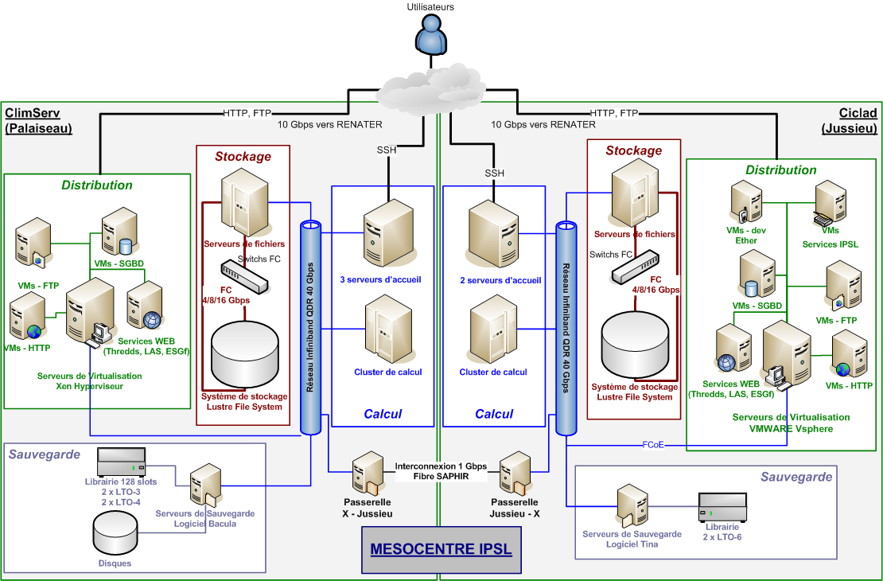
Mesocentre description
Network
High bandwith / Low latency Network: 40 Gbps Infiniband Network within each cluster (cluster intranet)
10 Gbps shared connection to Renater Network (Mesocentre Internet)
1 Gbps dedicated fiber channel connection between ClimServ and Ciclad
(https://www.nics.tennessee.edu/computing-resources/file-systems/io-lustre-tips)

Slide 10
Mesocentre description
Storage and filesystem
Mesocentre disk spaces:
All disk spaces are visible from the clusters (ClimServ/Ciclad) of the mesocentre
Data stored on ClimServ are mounted read-only via NFS on CICLAD
Data stored on CICLAD are mounted read-only via NFS on ClimServ
Because of the network topology of the mesocentre, it is advisable to work on the cluster closest to the processed data
User directories:
Data directories:
ClimServ: /bdd
CICLAD: /etherfs, /prodigfs, /loceanfs, /ccc
ClimServ
Directory | Limits | Backup
/home | 10Gb | 300 000 files | Daily incremental
/homedata | 200Gb | 300 000 files | 15-day differential
/ciclad-home | Read-Only | N/A
/data | Read-Only | N/A
CICLAD
Directory | Limits | Backup
/home | 20Gb | 300 000 files | Daily sync /backupfs
/data | 1To | 300 000 files | No
/climserv-home | Read-Only | N/A
/homedata | Read-Only | N/A

Slide 11
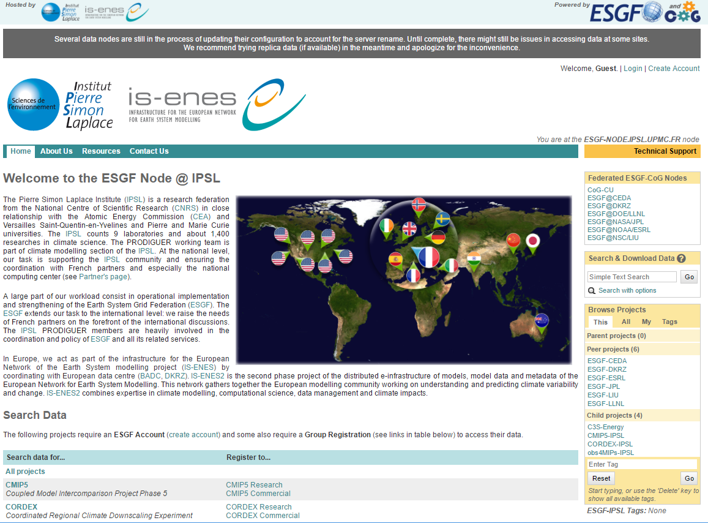
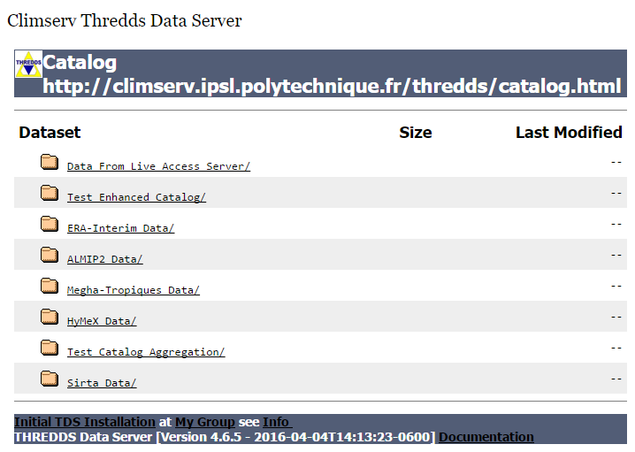
Mesocentre description
Project hosting and data distribution
Virtualisation system
Two virtualisation systems based on VMWARE and Xen are used to host applications using data from the mesocentre, while optimally adjusting the resources required.
Data distribution services: Data produced or hosted on the mesocentre can be made available through several distribution services according to the needs of the project
FTP
HTTP
THREDDS Data Server

Slide 12
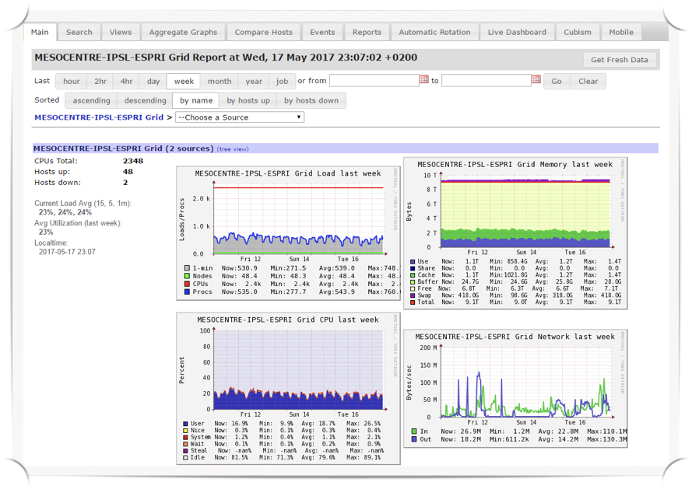
Mesocentre description
http://meso-ganglia.ipsl.fr

Slide 13
Mesocentre description
History
Climserv (Ecole Polytechnique) 1996
CICLAD ( UPMC ) 2008
Node interconnection Infiniband 40Gb/s (2012)
Interconnection by dedicated 1Gb/s link 2015
ESPRI Mesocentre (Climserv + Ciclad) 2017
Website: http://mesocentre.ipsl.fr/
Support
Mail to: meso-support@ipsl.fr
This is ticket system not mailing list
thank you to answer only if problem persist
or adding information (answering reopen tickets)
Don't use old ticket to ask something new
this is added to the old ticket
Try to be precise even in subject ;-) when asking
For SSH: Your workstation OS? OS version?
For jobs: jobs number? Script path? Script outputs?

Slide 14
Mesocentre description
Hardware
Head nodes
SSH Connection Access (5)
Computing nodes
50 nodes (2400 AMD core)
32 or 64 core per node (4 sockets )
Memory 4GB/core
Filers nodes
Lustre parallel Filesystem ( 3Po )
25 physical servers
More than 1300 hard disk
Virtualisation nodes
VMWare and XEN

Slide 15
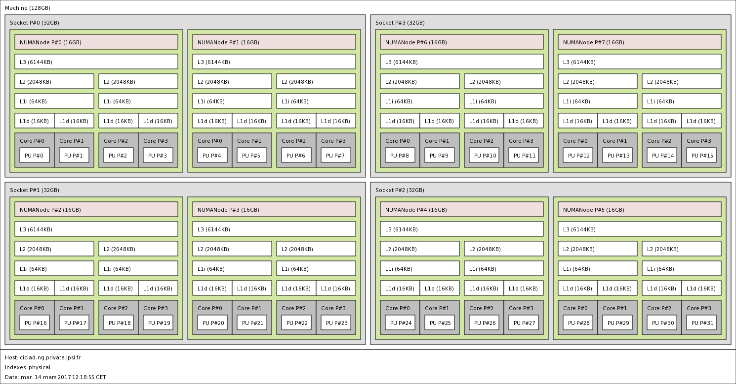
Mesocentre description
Computing node architecture
NUMA (Non Uniform Memory Access)

Slide 16
Mesocentre utilities
module command
Now ESPRI Mesocentre (CICLAD and ClimServ) is using the module command for software initialisation
module (avail [product] | load product[/version] | list | switch product/version1 product/version2 | display
product[/version]: Product could be a compiler, a library or a software
avail — List all known product and versions
load — Initialise a product in his default version if no version is specified
list — List already loaded product and version
switch — Changing the version of already loaded product
purge — Unload product
display — Show the module file

Slide 17
Mesocentre utilities
module command
> module avail
--------------------------------------------- /usr/share/Modules/modulefiles ---------------------------------------------
dot module-git module-info modules null use.own
----------------------------------------------- /etc/modulefiles/Compilers -----------------------------------------------
gnu/4.4.7(default) intel/12.1.3.293(default) nagfor/5.3 pgi/2013(default)
gnu/4.7.2 intel/15.0.6.233 nagfor/6.0(default) pgi/2016
[…]
----------------------------------------------- /etc/modulefiles/Libraries -----------------------------------------------
cmor/2.9.1-gfortran hdf5/1.8.14-pgf2016 netcdf4/4.3.3.1-pgf2016 openmpi/1.4.5-pgfgcc
hdf5/1.8.10.patch1-gfortran netcdf4/4.2.1.1-gfortran oasis3-mct/2.0-gfortran openmpi/1.6.5-gfortran
[…]
----------------------------------------------- /etc/modulefiles/Products ------------------------------------------------
cdo/1.6.8(default) matlab/2010b.sp2 nco/4.6.1
ferret/6.7.2(default) matlab/2013b(default) pyferret/7.0.0
ferret/6.9 matlab/2015b python/2.7.3-epd7
[…]
> type pgf90
pgf90 est /opt/pgi-2013/linux86-64/2013/bin/pgf90
> module load pgi/2011
> type pgf90
pgf90 est /opt/pgi-2011/linux86-64/2011/bin/pgf90
> type matlab
matlab est /opt/matlab-2013b/matlab
> module load matlab/2016b
> type matlab
matlab est /opt/matlab-2016b/matlab

Slide 18
Mesocentre utilities
module command
> module switch matlab/2010b.sp2
> type matlab
matlab est /opt/matlab-2010b.sp2/matlab
> module list
Currently Loaded Modulefiles:
1) pgi/2011 2) matlab/2010b.sp2
> module purge
> type pgf90
-bash: type: pgf90 : non trouvé
> module list
No Modulefiles Currently Loaded.

Slide 19
Mesocentre utilities
Preference to use anaconda Python
# Load Anaconda system instance
> module load python/2.7­anaconda
# Clone it
> conda create ­-n my_python ­­--clone /opt/anaconda
# Activate the resulting Python virtual environment
source activate my_python
# After you could add any personal package using:
> conda install pkg_name
> pip install pkg_name
> easy_install pkg_name
# Deactivate the environment
source deactivate my_python

Slide 20
Mesocentre utilities
Managing jobs
A job is a script (Shell, Perl, Python, etc. Not a binary)
To submit a job you need to ask some resources (memory, running time, number of cpu, etc.)
Not used asked resources is lost for everybody
You script run on another node , cpu and memory asked is dedicated .

Slide 21
Mesocentre utilities
Managing jobs
Batch system commands:
Function | Command
Launch a job | qsub
How many jobs in queue | qstat / showq
Kill a job | qdel
Nodes state | check-cluster / pbsnodes
Modify a job (not running) | qalter

Slide 22
Mesocentre utilities
Managing jobs
Execution queues
qstat -q to show all queues definitions
qstat -Qf [queue-name] to see full definiton
8 queues
WALLTime are in Hour
CPUTIME is unlimited
Queue Memory CPU Time Walltime Node Run Que Lm State
---------------- ------ -------- -------- ---- --- --- -- -----
short -- -- 02:00:00 -- 0 0 -- E R
default -- -- -- -- 0 0 -- E R
std -- -- 06:00:00 -- 1 0 -- E R
h12 -- -- 12:00:00 -- 0 0 -- E R
day -- -- 24:00:00 -- 0 0 -- E R
days3 -- -- 72:00:00 -- 0 0 -- E R
week -- -- 168:00:0 -- 0 0 -- E R
weeks2 -- -- 340:00:0 -- 0 0 -- E R
infini -- -- 840:00:0 -- 0 0 -- E R

Slide 23
Mesocentre utilities
Managing jobs
User limits (March 2017):
No more than 24 actives Jobs or 24 cpu core
No more than 3 active jobs in infini queue
No more than 4 active jobs in weeks2 queue
No more than 8 active jobs in week queue
No more than 16 active jobs in days3 queue
No more than 24 active jobs in other queue
By default memory is limited to 4GB by process
Please don't stress interactive nodes you could do interactive work with batch system:
qsub -IV[X] [ -q short|std|h12 ]

Slide 24
Mesocentre utilities
Managing jobs
Nodes status:
pbsnodes -l — List out of order nodes or reserved node for sysadmin
pbsnodes -a — List all nodes state
check-cluster (local command)
> check-cluster
NODE STATE FREE-CPU FREE-MEM LOAD PROPERTY PARTITION
ciclad5 Running 1/8 10/31 Gb 7.08 [std] std
ciclad10 Idle 8/8 31/31 Gb 0.24 [std] std
ciclad18 Busy 0/32 26/126 Gb 32.13 [std] std
ciclad19 Running 63/64 249/252 Gb 0.62 [heppi] std
ciclad20 Idle 64/64 252/252 Gb 0.06 [heppi] std
ciclad21 Idle 64/64 252/252 Gb 0.04 [heppi] std
ciclad22 Running 32/64 152/252 Gb 32.05 [heppi] std
10 Active Jobs 72 of 304 Processors Active (23.68%)
4 of 7 Nodes Active (57.14%)
Total Jobs: 12 Active Jobs: 10 Idle Jobs: 0 Blocked Jobs: 2

Slide 25
Mesocentre utilities
Managing jobs
qstat command:
qstat — List all jobs (not only yours)
qstat -q — Give queue definition information
qstat -a — List all jobs with more info ( should be a good default)
qstat -n — List also node used by jobs
qstat -f num_job — Give all info on one job
showq command:
Could be complementary with qstat
3 states for a job
Running
Idle (no resources for running now but should start when free resources are sufficient)
Blocked (you are over your limits or asking impossible resources)
showq -i — To see idle jobs
showq -b — To see why jobs are blocked

Slide 26
Mesocentre utilities
Managing jobs
qdel command:
qdel job_num — You can find job number by qstat or showq
qsub command:
qsub [-a date_time] [-A account_string] [-c interval] [-C directive_prefix] [-e path] [-h] [-I] [-j join] [-k keep] [-l resource_list][-m mail_options] [-M user_list] [-N name] [-o path] [-p priority] [-qdestination] [-r c] [-S path_list] [-u user_list] [-v variable_list][-V] [-W additional_attributes] [-z] [script]
man qsub — Display help
qsub -q queue_name my_shell_script
qsub -IV (-VI doesn't work anymore) — To launch interactive jobs
qsub -j oe — Joining standard and error output in one file
qsub -k oe — Keeping Standard and error output : could be see during the execution of your job but in this case those files are in the roots of your home (warn for quota if you have debug output in your job)

Slide 27
Mesocentre utilities
Managing jobs
# First thing to know is that only ShellScript (no binary files) could be submited to batch system and by default script start in your $HOME so you have to go in the good directory in your job # Minimum shell script is:
#!/bin/bash
my_binary
# Shell script must be runable
> chmod +x my_shell_script
> qsub my_shell_script
# At the end of your jobs you have two files
# The standard output of your job and node computation information ( node name running , cputime walltime and memory used by your job
> cat my_shell_script.o$JOB_NUMBER
# The error output of your job in case of problems
> cat my_shell_script.e$JOB_NUMBER

Slide 28
Mesocentre utilities
Managing jobs
qsub command:
qsub -v variable_name=variable_value — Permit to pass variables to shell script (argument on command line are not supported by torque)
In the script you can use $variable_name
You could put job directives directly in the script using line begining by #PBS:
#PBS -qweek
#PBS -k oe
#PBS -j oe
qsub -q queue_name my_shell_script
qsub -j oe -k oe job.sh — With this you could view in realtime output of your job in your home
tail -f job.sh.exxx
You can use IDL, Matlab, Scilab in batch jobs only if there is no X11 graphic in your job.
Graphic should be produced directly in .ps, .eps, .pdf or image formats.

Slide 29
Mesocentre utilities
Managing jobs
qsub command:
Default limit for jobs memory is :
4GB of virtual memory per Job
3GB of real memory per Job
How to launch job with more memory ?
mem — Memory per job
vmem — Virtual memory per job
Warning do not put those values to high without good reason
> qsub -l mem=10gb -l vmem=12gb
Mem: 32442980k total, 21798348k used, 10644632k free, 47112k buffers
Swap: 67111528k total, 2499232k used, 64612296k free, 14130248k cached
PID USER PR NI VIRT RES SHR S %CPU %MEM TIME+ COMMAND
12355 weill 25 0 9164m 8.1g 8.1g S 44 26.3 1:08.55 MATLAB

Slide 30
Mesocentre utilities
Managing jobs
qsub command:
Starting a job at specific time:
qsub -a time :
qsub -a 2010 — Lauch your job at 20:10
qsub -a $(date -d '+2min' +%H%M) — Launch this le job 2 minutes after submission. Use this when you have a job that submit another job at the end.
Specifying walltime and cputime :
qsub -l walltime=20:00:00,cput=80:00:00 — 20h of walltime with 80h of cputime
Jobs dependancy: running a job after the successful run of another job[s]
qsub -W depend=afterok:jobid[:jobid...]

Slide 31
Mesocentre utilities
Managing jobs
qsub command:
Submission of parallels jobs: qsub -l nodes=n:ppn=m
I want n nodes with m core by nodes
qsub -l nodes=1:ppn=2+nodes=3:ppn=8 — Special request of one node with 2 core and 3 nodes with eight core
Job MPI:
mpirun program
Batch system pass the number of CPU to MPI program
-np is not necessary except for special purpose.

