Slide 1
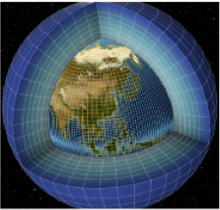
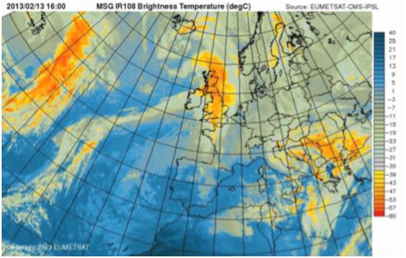
Module 2
Data you can find or access
Model data
Observational data

Slide 2
Introduction
Objectives of data management on the mesocentre:
The data close to the computing facility used by IPSL Labs
To ease the use of observation and model data ➯ IPSL: a unique place
To allow a mix use of different data types (model data, in-situ, satellites, reanalyses):
Which data?
Data produced by the IPSL scientific community
Data from other data centres or communities
The organised archive of data ≈ 1.6Po

Slide 3
Introduction
Different services proposed by the ESPRI team:
Data management (acquisition, production, archival )
A centralised management of datasets:
To avoid the duplication of dataset on individual user account.
Open data/protected data:
Some data are non public.
Tools for distribution and computation on data, access to the data
Documentation on data (cf web sites)
User and project support, close to the scientific teams
Dedicated workspaces for projects (specific storage for data exchange)
DOI: IPSL is allowed to generate DOI on data (INIST convention)

Slide 4
Observation Data
What we do?

Slide 5
Observation Data
What we do?
The services around the observation data:
Different types of observation data: in-situ, satellite, reanalyse, FCDR, etc.
Data management, a collaborative task:
Centralised data of interest on demand
If you have dataset, you can propose to share it on the mesocentre
Data from IPSL team or from other data centres (mirroring)
Formatting in NetCDF in some cases
Services for the valorisation of YOUR dataset (website, dedicated access and quick look)
Where are the observation data on the mesocentre?
/bdd — Long term datasets on water cycle, clouds, etc.
/etherfs — Atmospheric chemistry dataset
How to find the information?
On websites (today): climserv.ipsl.polytechnique.fr or cds-espri.ipsl.fr
Mail to meso-support@ipsl.fr (Cathy Boonne, Sophie Cloché, Karim Ramage)

Slide 6
Observation Data
Examples of observation data on /bdd
In-situ data:
Campaigns measurement :CAL/VAL MT, balloons, etc.
Systematic measurements: SIRTA
Post-processing of in-situ Radiosounding: ARSA, TIGR
Others.
Satellite L1/L2/L3 products :
AMSU L1C, TRMM, SSMI, Wentz products (SSMI, TMI), GSSTF,
CALIOP L1/L2, IIR L1/L2
GEO (HDF) pour MT, METEOSAT, MSG, ISCCP, CLAUS, SAF-LAND
ScaRaB 1/2, CERES, ERBE, GERB, NOAA-OLR
POLDER1/2, PARASOL, MODIS, AVHRR,
NVAP, GPCP, CPC, HOAPS
AVISO, OISST (MW), OISST-NOAA, OAFLUX, SAFOSI, QUIKSCAT
CFMIP-obs, GEWEX/CA, clear sky WV radiance, Emissivité surface MW
Others
Satellite/model outputs for INDOEX, AMMA, HyMex (+ radar), ChArMEx
Try to centralise WRF forcing data.

Slide 7
Observation Data
Examples of observation data on /bdd
Focus on reanalysis dataset: climate and satellite reanalysis
On the IPSL mesocentre (and on IDRIS and TGCC)
In NETCDF format (+ GRIB at IDRIS)
Available through ssh, FTP or OpenDAP
(Re)Analyses
ECMWF (protected by MeteoFrance convention): ERA40 ERA-Interim ERA20C Analyses 1.125° COPERNICUS C3S: ERA5
MERCATOR-OCEAN: GLORYS2V3 MEDRYS1V1 OSTIA_SST
NASA: MERRA1/2
NCEP1/2 NCEP/CFSR v1 NCEP FNL
NOAA CIRES 20th century reanalysis v2 (20CRv2)
FCDR
Archive AMSU (2000- présent)
Archive SSMI (1987-présent)
GridSat Géostationnaires (1980-présent)

Slide 8
Observation Data
Examples of observation data on /etherfs
Databases
Databank
Operational
observation
Satellite
observation
In situ
observation
Flight
observation
/etherfs
Balloon
observation
Campaign data
Volume ≈ 470To

Slide 9
Observation Data
Which observation data on /etherfs ?
/etherfs data management context: 470To
A huge variety of data sets: 250 from level 1 to 4
Earth satellite data from UARS, ADEOS1, ERBS, POAMII, POAMIII, ODIN, ENVISAT, METOP/IASI – GOME2 and GOSAT missions
Ground-based and in-situ data : Lidar, Radar, Balloon, gondolas, aircraft data, radio sounding, etc.
Modelling data from REPROBUS, MIMOSA, etc.
Ancillary data like spectroscopic data (GEISA), kinetic data, etc.
1984
1991
1996
1998
2001
2002
2007
2009
2012
2018
SAGE II
UARS
SPOT3
SPOT4
ODIN
ENVISAT
Metop-A
GOSAT
Metop-B
Metop-C

Slide 10
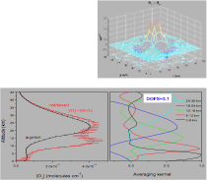
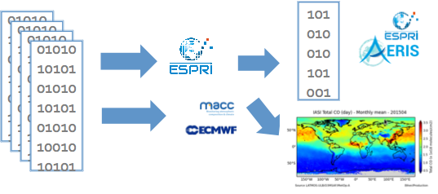
Observation Data
Satellite data management and distribution : IASI example
CO data treatment
IASI L1C spectra
FORLI – CO
LATMOS/ULB
Data distribution
Added values
CO data retrieval
Production level 2 data and QL on the fly
Currently, IASI O3, CO, SO2, HCOOH data retrieval and production uses IPSL Mesocentre.

Slide 11
Observation Data
Satellite data management and distribution
Satellite data and quick looks distribution:
On the IPSL mesocentre
In native format
Available through SSH or HTTP
Satellite data | Format | Distribution type
IASI level 1C (METOP-A-B) | BUFR | SSH
IASI level 2 (O3, CO, SO2, CH4, HCOOH, NH3) | ASCII, NetCDF | HTTP
AMSUA-MHS-HIRS4 level 1C (METOP-A-B) | BUFR | SSH
GOME2 level 1B (METOP-A-B) | HDF | SSH
GOME2 level 2 (METOP-A-B) | HDF, NetCDF | SSH
GOSAT level 1B / FTS/CAI | HDF | SSH
GOSAT level 2 / FTS/CAI | HDF | SSH
SAGE II, UARS, SPOT3, SPOT4, ODIN, ENVISAT (level 2) | Native | HTTP
Non public data

Slide 12
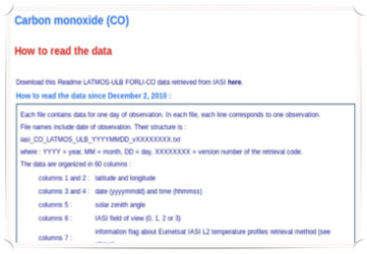
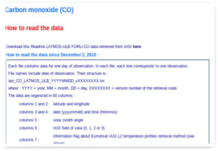
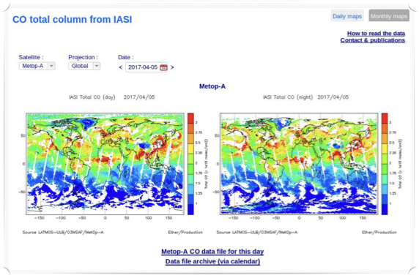
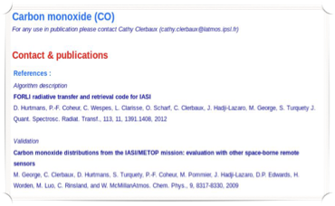
Observation Data
Satellite data management and distribution
Distribution through cds-espri.ipsl.fr

Slide 13
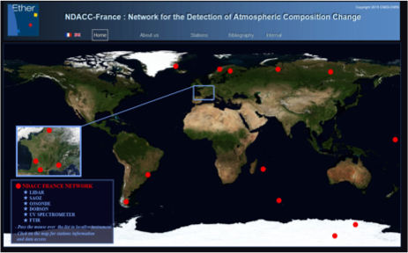
Observation Data
Ground based and in situ data
Ground based and in situ data and quick looks distribution (ACTRIS-FR)
On the IPSL mesocentre
In ames format
Available through ftp or http
17 stations:
OHP, La Réunion, Dumont d'Urville,
OMP, Villeneuve d'Ascq, Briançon,
Scorebysund, Andoya, Sodankyla,
Zhigansk, Salekhard, Bordeaux,
Tarawa, Bauru, Kerguelen,
Rio Gallegos, Concordia
Atmospheric components measured:
O3 tropo et strato,
NO2,
Temperature,
Aerosols
http://cds-espri.ipsl.fr/NDACC/

Slide 14
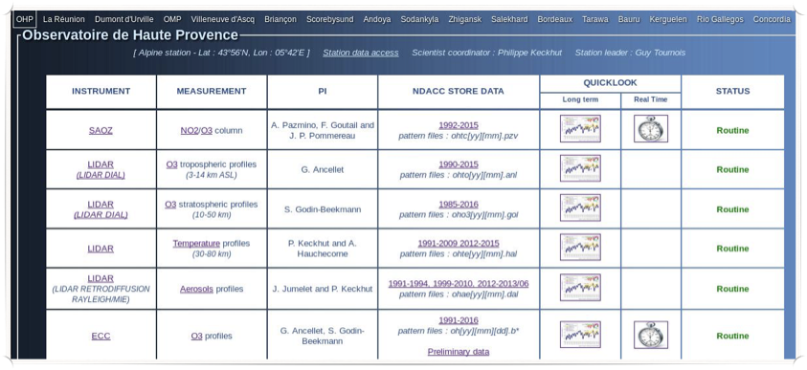
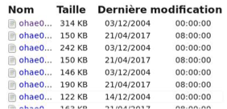
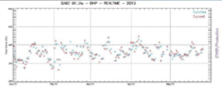
Observation Data
Ground based and in situ data
Distribution data via FTP

Slide 15
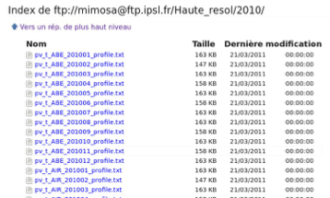
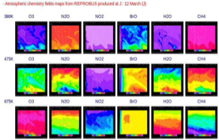
Observation Data
Model data distribution
Model data and quicklooks distribution
On the IPSL mesocentre
In native format
Available through HTTP, FTP
MIMOSA :
Potential vorticity and temperature fields: daily analysis and forecasts production (Mimosa model, North and South Hemisphere and Tropic)
REPROBUS:
50 atmospheric constituent fields
(O3, ClO, NO2, N2O, BrO, etc.):
daily analysis production (REPROBUS
model)

Slide 16
Observation Data
GEISA 2015 data distribution
GEISA data distribution:
On the IPSL mesocentre
In native format
Available through HTTP only (cds-espri.ipsl.fr/GEISA)
Three SUB-DATABASES:
Line parameters sub-database
52 molecules (113 isotopic species)
Over 4,800,000 entries in the spectral range
10-6 - 35,877 cm⁻¹ (1010 - 0.28 µm)
(Major permanent constituants of EARTH atmosphere: O2, H2O, HDO, CO2, etc. and trace molecules: CH4, NO, SO2, NO2, NH3, HNO3, OH,HF, HCl, HBr, HI, ClO, OCS, H2CO, PH3)
(Molecules in atmospheres of JUPITER, SATURN, URANUS,TITAN, etc.: C6H6, CH4, CH3D, C2H2, C2H4, GeH4, HCN, C3H8, C3H4)
Absorption cross-sections sub-database (IR and UV/Visible)
Microphysical and optical properties of atmospheric Aerosols sub-database

Slide 17
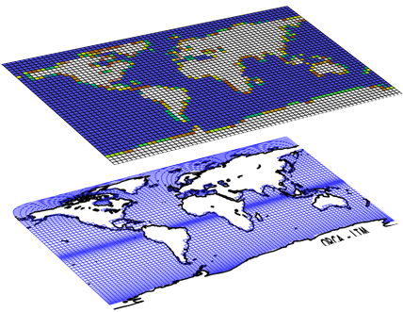
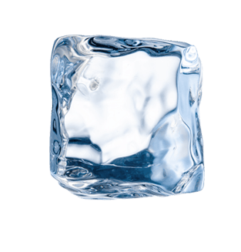
Model data
Climate models: example of IPSL-CM
INCA/REPROBUS
(Chimie atmosphérique + Aérosols)
LMDZ
(Atmosphère)
ORCHIDEE
(Surfaces continentales +
Végétation)
OASIS
(Coupleur)
NEMO
PISCES
(Biogéochimie marine)
OPA
(Dynamique océanique)
LIM
(Glace de mer)

Slide 18
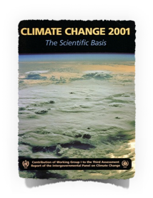
Model data
IPCC Assessment Report cycle
The group's objective is the study of natural and anthropogenic variability in the global climate system. IPSL is also studying climate change impacts and usage of climate projections for adaptation to climate change related to industry. IPSL is one of the climate modelling centre of international repute contributing to the IPCC (Intergovernmental Panel on Climate Change).
IPCC ARs
Collect the state of the art in
understanding the climate system
#2
#3
#4
#5
…
…

Slide 19
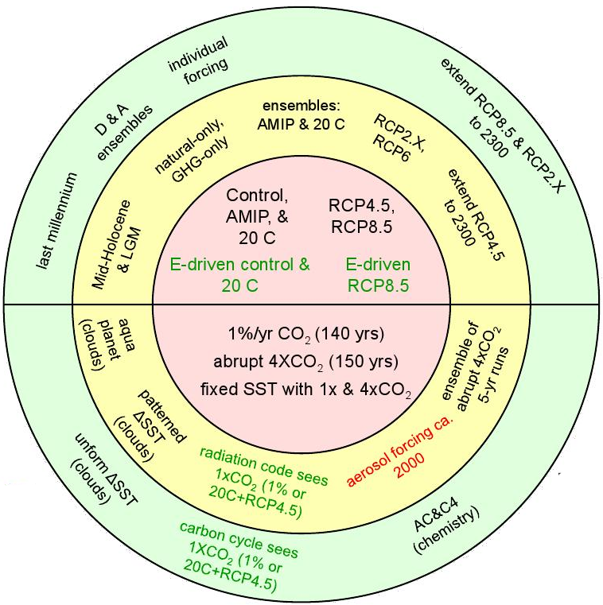
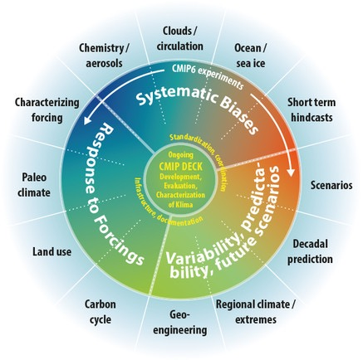
Model data
Couple Model Intercomparison Project
From phase 5 (CMIP5)
To phase 6 (CMIP6)

Slide 20
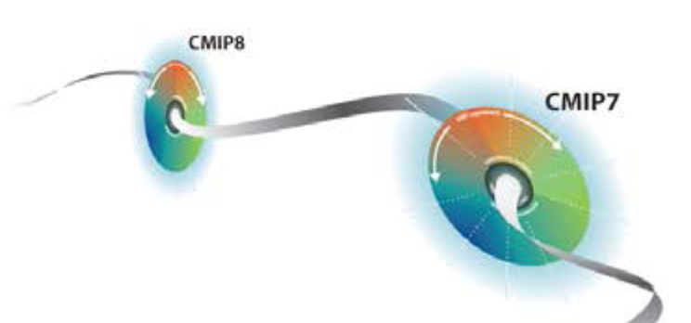
Model data
Couple Model Intercomparison Project
Many, many processes !
Many, many (interconnected) communities !
Many, many closed tied projects:
input4MIPs | Input datasets for Model Intercomparison Projects
ISIMIP | Inter-Sectoral Impact Model Intercomparison Project
GeoMIP | Geoengineering Model Intercomparison Project
PMIP3 | Paleoclimate Modelling Intercomparison Project
TAMIP | Transpose-Atmospheric Model Intercomparison Project
EUCLIPSE | European Union Cloud Intercomparison, Process Study and Evaluation Project
LUCID | Land-Use and Climate, IDentification of robust impacts

Slide 21
Model data
The Coordinated Regional Climate
Downscaling Experiment (CORDEX)
The CORDEX vision is to advance and coordinate the science and application of regional climate downscaling through global partnerships. CORDEX goals are:
To better understand relevant regional/local climate phenomena, their variability and changes, through downscaling,
To evaluate and improve regional climate downscaling models and techniques,
To produce coordinated sets of regional downscaled projections worldwide, and
To foster communication and knowledge exchange with users of regional climate information.
CORDEX domains

Slide 22
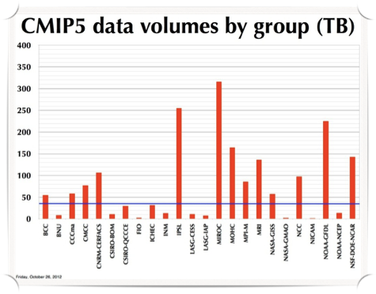
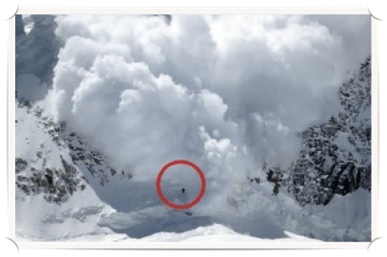
Model data
Climate « big » data
CMIP5 data archive final status
1.8 PB for 59,000 datasets, 4.3 Mio Files,
60 climate models
CMIP5 data is about 50 times CMIP3.
Extrapolation to CMIP6
CMIP6 has a more complex experiment structure than CMIP5,
More models, finer spatial resolution and larger ensembles,
Factor of 20: 36 PB in 86 Mio Files
Factor of 50: 90 PB in 215 Mio Files
CNRM
IPSL
: CMIP3 (≈35TB)
?
?
?
?
?

Slide 23
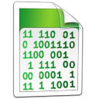
Model data
A world of ‘facets’
Computation is useless if results cannot be stored, distributed or read.
The conventions for Climate and Forecast metadata (http://cfconventions.org/) are designed to promote the processing and sharing of files created with the Network Common Data Form (NetCDF). The conventions define metadata that provide a definitive description of what the data in each variable represents, and the spatial and temporal properties of the data.
Data Request
The Data Request is coordinated by the WGCM Infrastructure Panel. The requested variables and their output frequencies can be filtered following the scientific backdrop of the WCRP Grand Challenges and additional scientific themes to investigate.
Data Reference Syntax defines the directory structure and the available values for each directory. The DRS also fixed the filename pattern. A DRS is crucial for a clear and efficient management of their publication.

Slide 24
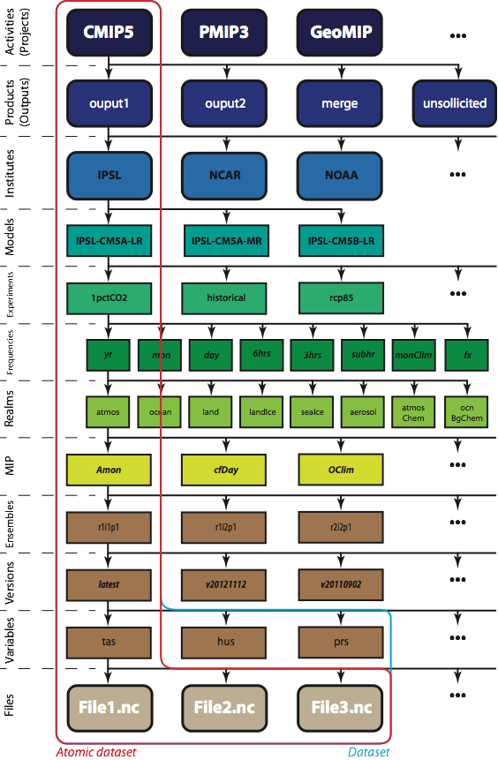
Model data
The concept of ‘dataset’
A ‘dataset’ (as defined by publication) is ONE version of a data set resulting from a single simulation (i.e., characterised by a unique option of each attribue of the DRS before the version such as the institute, the model, the domain, the experiment, the frequency, the ensemble, etc.).
Examples:
CMIP5 dataset: output1/IPSL/IPSL-CM5A-LR/1pctCO2/mon/atmos/Amon/r1i1p1/v20110427
CORDEX dataset: output/EUR-11/IPSL-INERIS/IPSL-IPSL-CM5A-MR/historical/r1i1p1/IPSL-INERIS-WRF331F/v1/mon/tas/v20140301
A dataset is the finest granularity for publication.

Slide 25
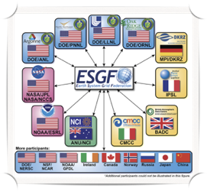
Model data
ESGF integration and international broadcasting
A decentralised and federated nodes network with international collaboration. Each ESGF Node is composed of services and applications that collectively enable metadata discovery, data access, and user management.
Operational since 2011
Hundreds of users per month
Hundreds of TB per month
About 10,000 registered users
IPSL climate models get involved in several projects
Metadata catalogs,
Access protocols to data endpoints.
IPSL-CM results
ESGF datanode
Indexes and broadcasts available data from all datanodes,
Front-end with search UI,
Links with models documentation,
Redirects users requests to the appropriate datanode.
Scientific community
ESGF indexnode

Slide 26
Model data
How ask for new data?
The IPSL mirrors at the request of its researchers a relatively large subset of ESG-F data (currently 420To) on its local filesystem. A post-processing pipeline is available to analyse climate simulations in the best conditions.
ESG-F nodes
IPSL users requests
Automated download
IPSL users
Safe usable data
Post-processing

Slide 27
Model data
Edit a SYNDA template
# Edit a template
> vi my_template.txt
# My SYNDA template
project=CMIP5
experiments=historical amip
models=IPSL-CM5A-LR CNRM-CM5
ensembles=all
variables[atmos][3hr]=cltc tas
variables[land][fx]=sftgif
variables[seaIce][mon]=sic evap
Send your request to:
Guillaume Levavasseur: glipsl@ipsl.fr

Slide 28
Model data
Where on IPSL mesocentre?
# Location on CICLAD filesystem
> ls -l /prodigfs/project/
total 64
drwxr-sr-x 7 tnoel ciclad 4096 Jul 11 2016 BCCORDEX
drwxrwsr-x 7 brocksce carbon 4096 Feb 24 12:25 CARBON
drwxrwsr-x 6 sdipsl cmip5 4096 Mar 30 15:35 CLIM4ENERGY
drwxrwsr-x 6 jllod cmip5 4096 May 5 2012 CMIP3
drwxr-xr-x 4 sdipsl cmip5 4096 Jan 25 07:47 CMIP5
drwxr-xr-x 3 sdipsl cmip5 4096 Feb 27 14:23 CMIP5-Adjust
drwxr-xr-x 4 sdipsl cmip5 4096 Feb 27 14:27 CORDEX
drwxr-xr-x 3 sdipsl cmip5 4096 Feb 27 14:23 CORDEX-Adjust
drwxr-xr-x 4 tnoel ciclad 4096 Feb 24 12:20 DRIAS
drwxr-xr-x 3 sdipsl cmip5 4096 Sep 12 2015 EMBRACE
drwxr-xr-x 7 brocksce ipsl 4096 Feb 19 2016 EUROCORDEX
drwxr-sr-x 3 glipsl cmip5 4096 Apr 21 12:01 input4MIPs
drwxrwxr-x 4 brocksce ipsl 4096 Jul 25 2014 MAREMIP
drwxrwxr-x 23 brocksce ipsl 4096 Jan 31 18:21 OCMIP5
drwxr-xr-x 4 sdipsl ciclad 4096 Nov 4 2014 ORCA025-LIM2-PISCES
drwxr-sr-x 3 sdipsl cmip5 4096 Jul 31 2014 SPOOKIE
> ls -l /ccc/work/cont003
total 0
drwxr-x--- 1 apache ccc 0 Jan 26 15:45 cmip5
drwxr-xr-x 1 apache ccc 0 Mar 8 21:16 cordex
drwxr-xr-x 1 apache ccc 0 Oct 25 2013 dods
drwxr-xr-x 1 apache ccc 0 Nov 19 2014 esgf
drwxr-x--- 1 apache ccc 0 May 12 15:07 thredds

Slide 29
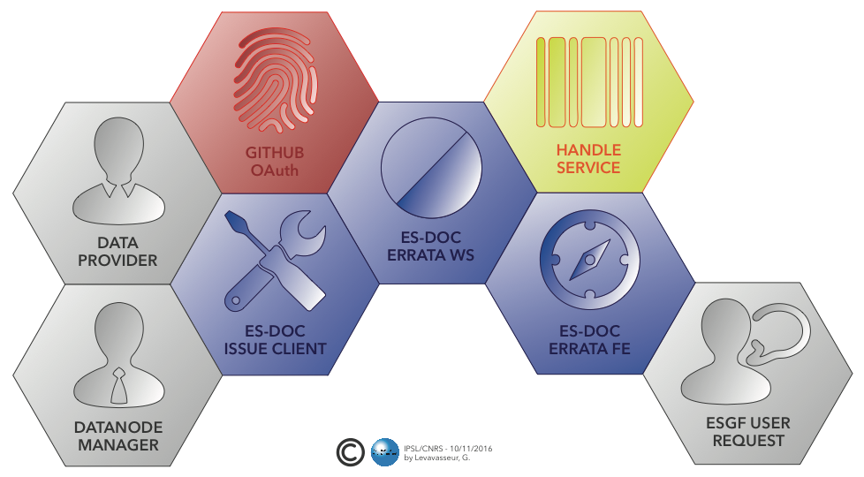
Model data
Documentation and errata
The potential to interpret, compare and reuse climate information results is strongly related to the quality of their description.
ES-DOC
Standards based eco-system in support of earth system modelling documentation creation, analysis & dissemination.
ES-DOC errata
Web-service to provide timely information about known issues and enable users to query about modifications and/or corrections applied to the data.

