Slide 1
Module 3
Tools for climate science

Slide 2
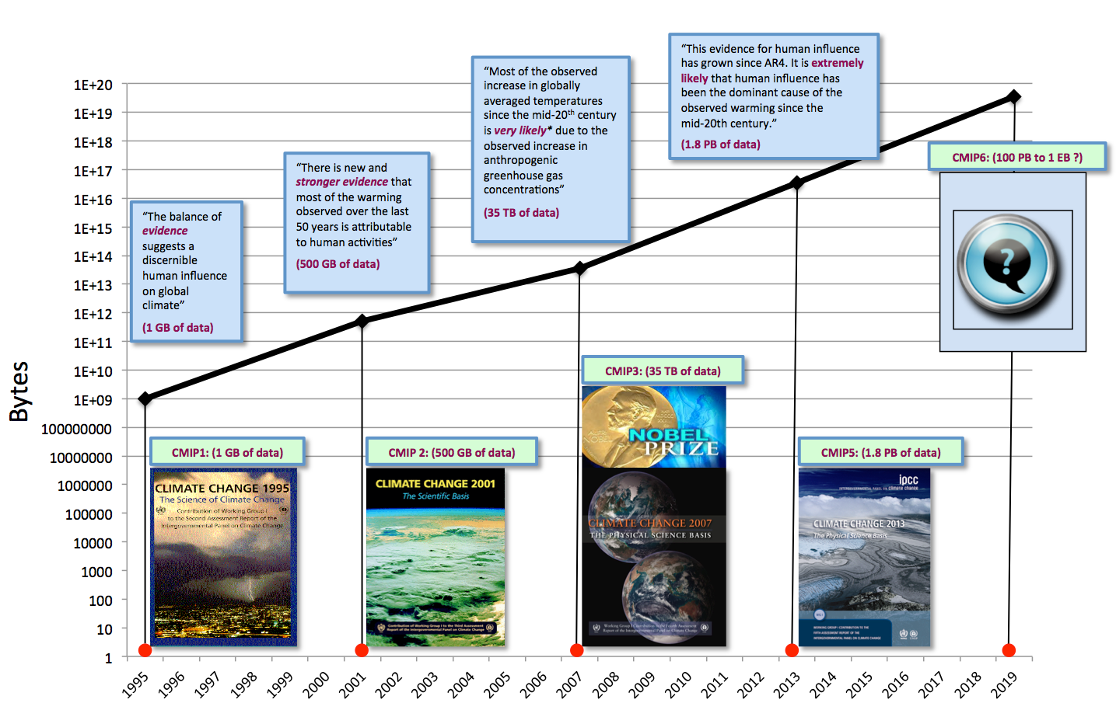
Introduction
CMIP: | +76%/year
Moore's law: | +42%/year

Slide 3
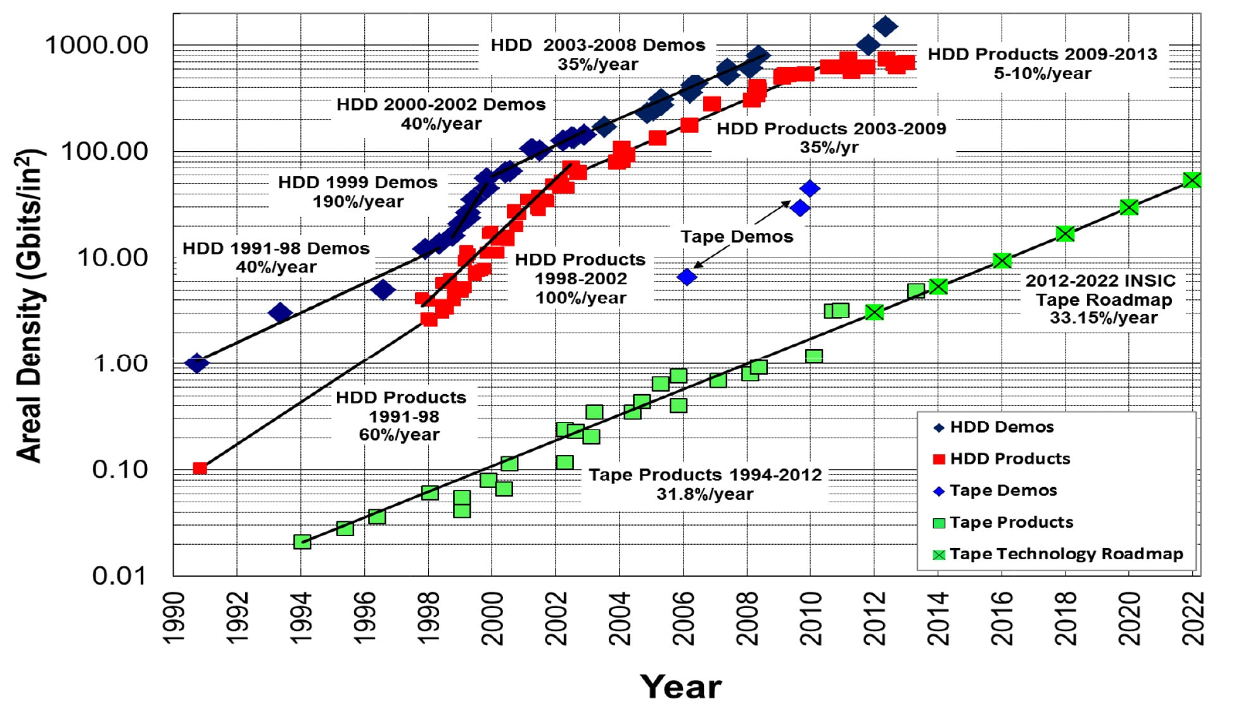
Introduction
CMIP: | +76%/year
HDD: | +45%/year

Slide 4
Introduction
Global data infrastructure
CMIPs, and in general any science involving cross-model comparisons, critically depend on the global data infrastructure – the “vast machine” (Edwards 2010) – making this sort of data-sharing possible.

Slide 5
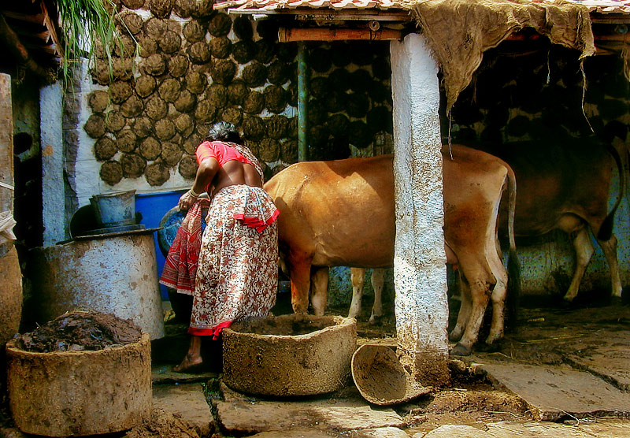
Introduction
Data producers
Observational and model output data in the climate-ocean-weather (COW) community is initially generated in some “native” non-standard format, and any subsequent relative analyses requires considerable effort to systematise. Issues include moving and transient data sources, lossy data formats, curvilinear and other “exotic” coordinates.

Slide 6
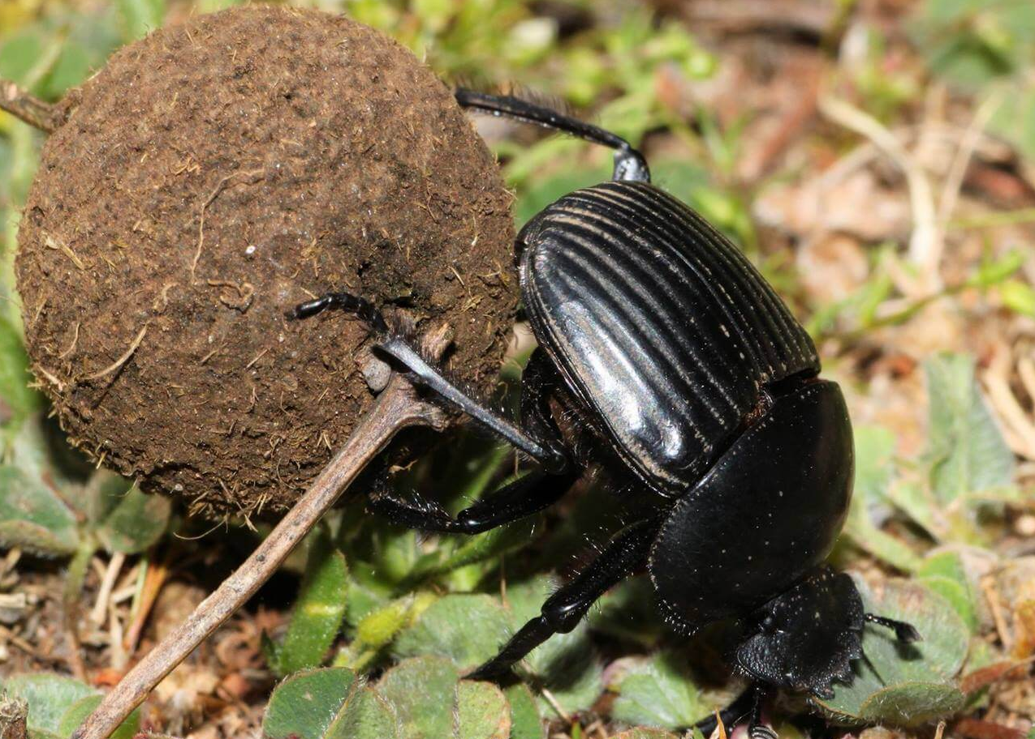
Introduction
Data organisers
Data organisers are the community within this ecosystem that facilitates the transformation of source dependent data to a neutral and readily consumable form. They maintain the standards for describing data in a manner that permits these transformations, and develop tools to perform them.

Slide 7
Introduction
Data consumers
Scientists perform sequences of computations (e.g. “poleward heat transport”, “length of growing season”) on datasets. Typically this is scripted in some data analysis language, and ideally it should be possible to apply the script to diverse datasets.

Slide 8
Introduction
Efficiency
Distribution of labor in a scientist's job
Writing Papers
Coding
Travels
0
20
40
60
80
Ideal
Reality

Slide 9
Introduction
Efficiency
Distribution of labor in a scientist's job
Writing Papers
Coding
Travels
0
20
40
60
80
Ideal
Reality

Slide 10
Introduction
Data fabric

Slide 11
Introduction
How to improve support for climate analyses?
Specific simulations, variables, frequency, time periods, etc.,
to run their simulations,
Overviews on data with simple graphics or maps,
Complex analyses using different languages (R, Python, Ferret, etc.)
Reproducibility of their analyses
Analyse reproducibility.
Researcher
Clarifying access to available data,
Simplifying simulations runs,
Automating recurring needs (means, anomalies, etc.),
Applying specific script,
Ensuring support and data management.
Researcher-friendly platform
Model code & libIGCM interface,
Data management,
Documentation and trainings,
Search API,
HERMES,
Web (Mapping) Services,
(Inter-)Monitoring,
Automated atlas.
Climate engineer

Slide 12
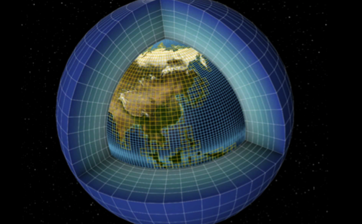
CliMAF
CliMAF Earth System Model Evaluation Platform
Evaluating/comparing a set of simulations/models on CICLAD

Slide 13
CliMAF
The C-ESM-EP — Definition
A predefined – community validated (IPSL-CNRM-CERFACS) set of evaluation diagnostics by component/thematic
An efficient way to systematically compare results of different simulations while benefiting from ways to finess the diagnostics (choosing the periods for a set of diagnostics, controlling the plot parameters…)
A front HTML page with links to the html pages of the atlases of the different components/thematics.

Slide 14
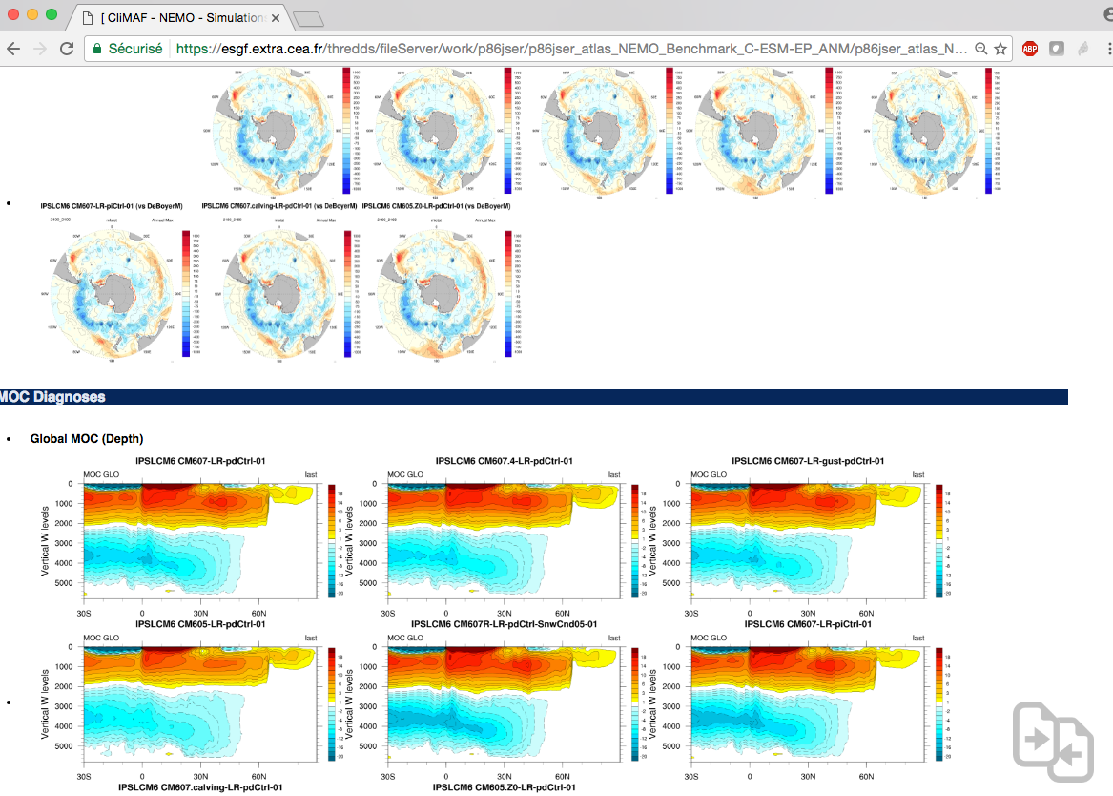
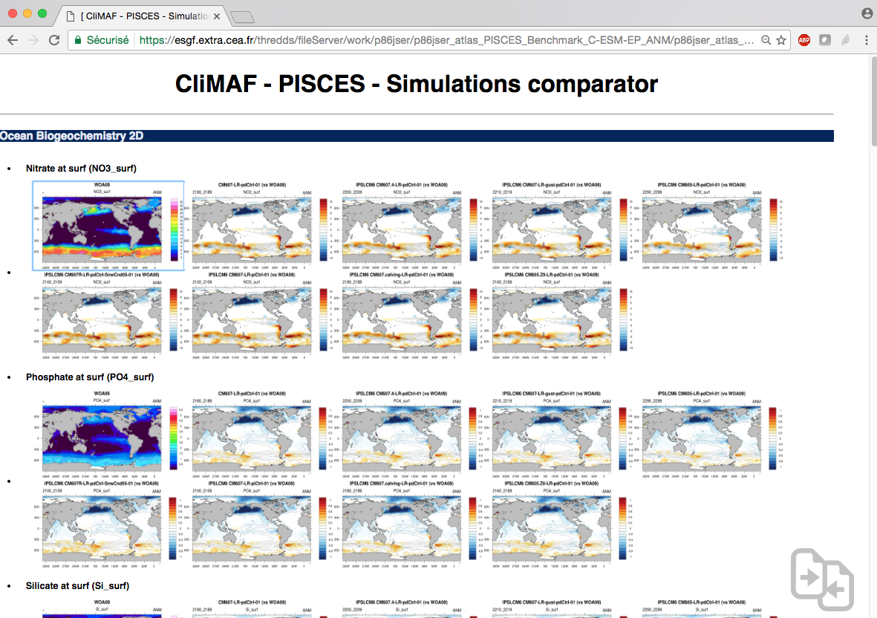
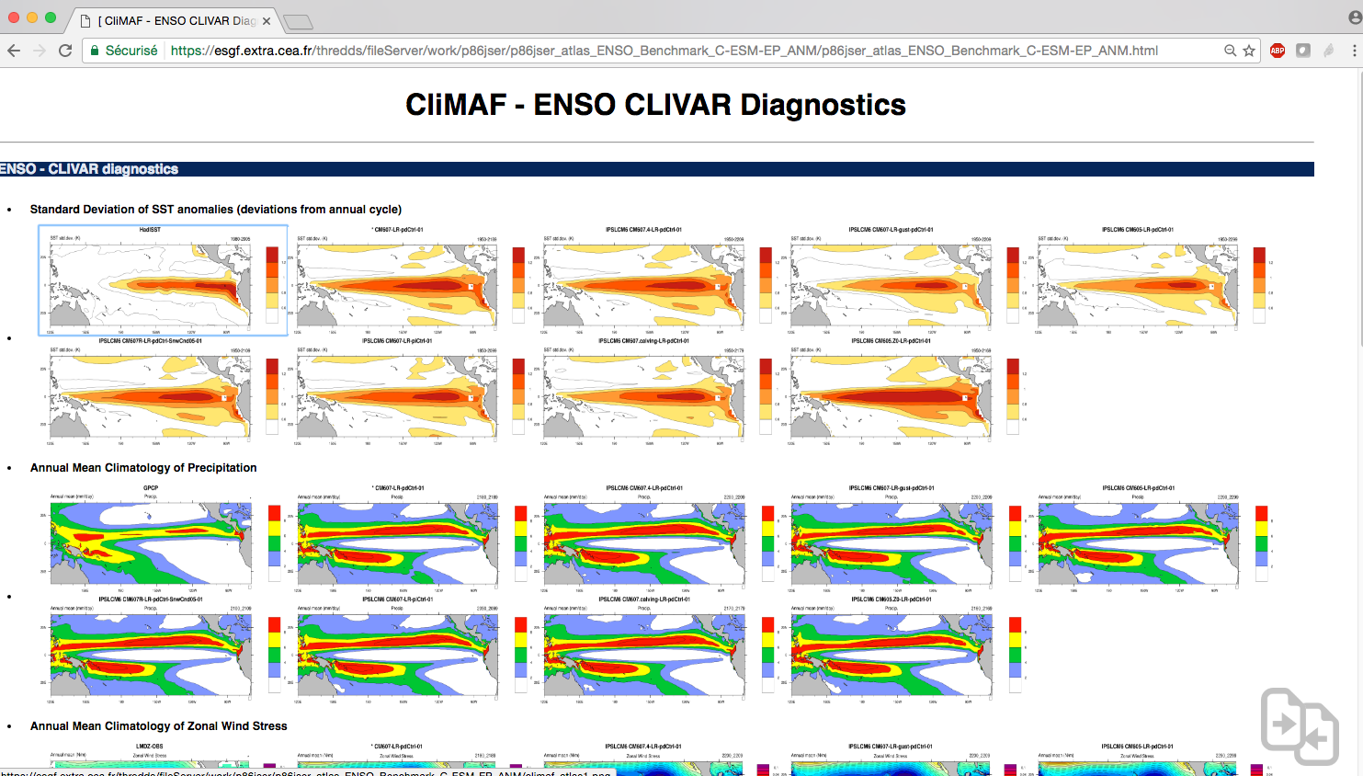
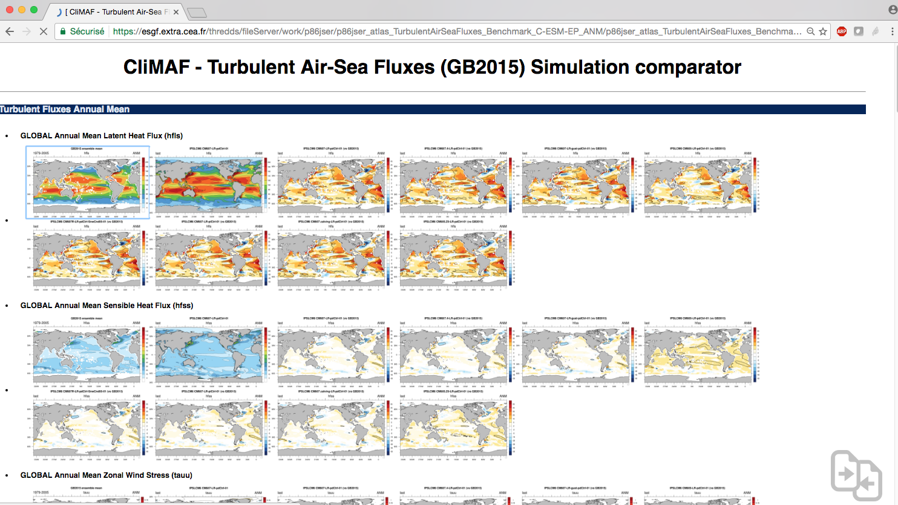
CliMAF
The C-ESM-EP

Slide 15
CliMAF
The C-ESM-EP
The C-ESM-EP is based on CliMAF (http://climaf.readthedocs.io/en/latest/), an advanced python framework developed in collaboration between CNRM-GAME and IPSL to provide the french community with an efficient way to gather-share diagnostics and apply them routinely on the climate models outputs.
S. Sénési, J. Servonnat, L. Vignon, O. Marti, P. Brockmann, S. Denvil
Contact: climaf@meteo.fr

Slide 16
CliMAF
The C-ESM-EP
Main strengths:
Standardised way to access the data ➯ Can be adapted to any CF-compliant NetCDF files ➯ Encourage sharing the diagnostics!
Automatically manage the output in a smart cache (uses the existing results) ➯ Fast!
Simplified way to do those daily pretreatments (averaging, period/geographical domain selection, etc.) based on CDO
Easy way to do plots (using an NCL script) and put them in an html page
Easy to plug your own script of diagnostic
Main weaknesses:
It’s not magic! You will get errors at some point (sorry)
Potentially slows down when the cache is loaded with results

Slide 17
CliMAF
The C-ESM-EP in a nutshell
The quick way to use the C-ESM-EP on CICLAD:
# Copy the sources in a working directory
> cd my_working_directory
> mkdir -p C-ESM-EP ; cd C-ESM-EP
> cp –r ${sources} . ; cp –r src work
> cd work
# Setup your comparison
> cp -r comparison_example/ my_comparison/
# Enter your datasets
> vi my_comparison/datasets_setup.py
# Run all the components together or just a subset:
> python run_C-ESM-EP.py my_comparison [Atmosphere_Surface,ENSO]
# See the results on the URL returned by run_C-ESM-EP.py
[..]
-- The CliMAF ESM Evaluation Platform will be available here:
-- https://vesg.ipsl.upmc.fr/thredds/fileServer/IPSLFS/jservon/C-ESM-EP_Benchmarck_Ciclad.html

Slide 18
CliMAF
CMIP5 and IGCM_OUT data access
Definition of a CMIP5 dataset and an IPSLCM6 simulation (SE):
models = [
dict(
project = ’CMIP5’,
model = ’IPSL-CM5A-LR',
experiment = ’historical',
simulation = ’r1i1p1’,
frequency = ’monthly',
period = ’1980-2005'
),
dict(
project = 'IGCM_OUT’,
root = '/ccc/store/cont003/thredds',
login = 'p86caub',
model = 'IPSLCM6',
simulation = 'CM605-LR-pdCtrl01',
frequency = 'seasonal',
clim_period = '2020_2029'
)
]
More details on the data access in the demo/TP.

Slide 19
CliMAF
Atlas Explorer — Definition
An easy and flexible working space within the C-ESM-EP to produce an HTML page showing climatologies and difference maps (with a reference) on a set of datasets (simulations, models, different periods…)
Provide the user with a set of predefined features to assess a variable (plotting parameters, default observational reference) while keeping control on the diagnostics from only one parameter file.

Slide 20
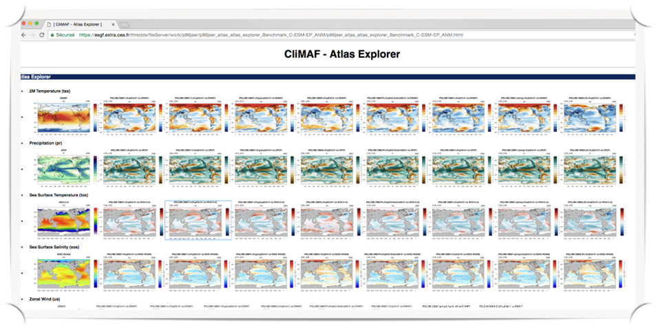
CliMAF
Atlas Explorer
Simulations – datasets
Variables
(Seasons, projections, domains, etc.)

Slide 21
CliMAF
Atlas Explorer
The quick way to use Atlas Explorer on CICLAD:
# Install the C-ESM-EP and setup a comparison
# (as seen for the C-ESM-EP)
# Go into the directory of your comparison
# Add your datasets in datasets_setup.py
> cd my_comparison
> vi datasets_setup.py
# Edit the Atlas Explorer parameter file to setup what you need
> vi AtlasExplorer/params_AtlasExplorer.py
# Run the Atlas Explorer interactively:
> ./job_C-ESM-EP.py AtlasExplorer
# See the results on the URL returned at the end of the execution
# Or submit a job from the main directory
> cd ../
> python run_C-ESM-EP.py my_comparison/ AtlasExplorer

Slide 22
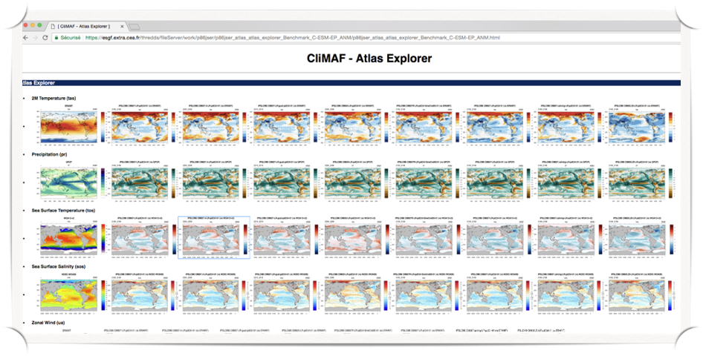
CliMAF
Atlas Explorer — The ‘compareCompanion’
Display a selection of figures on the fly:

Slide 23
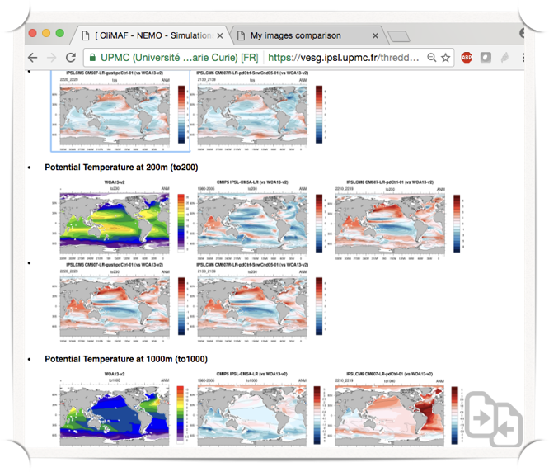
CliMAF
Atlas Explorer — The ‘compareCompanion’
Display a selection of figures on the fly:

Slide 24
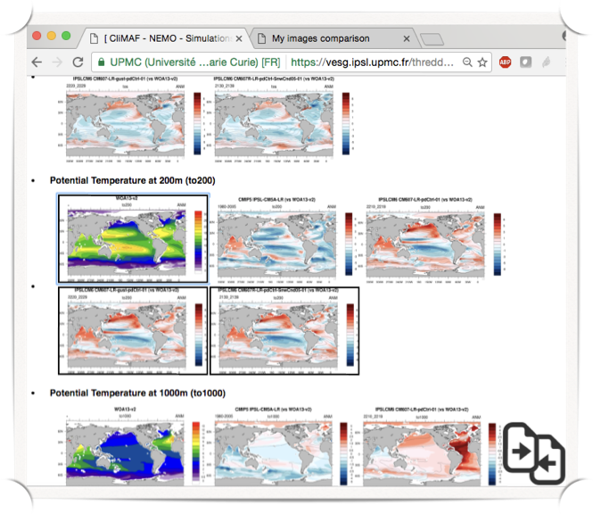
CliMAF
Atlas Explorer — The ‘compareCompanion’
Display a selection of figures on the fly:
Select the images by putting the mouse over the plots and press ‘s’ (for ‘select’)
A black line is drawn over the selected plots

Slide 25
CliMAF
Atlas Explorer — The ‘compareCompanion’
Display a selection of figures on the fly:
Click on the bottom right icon

Slide 26
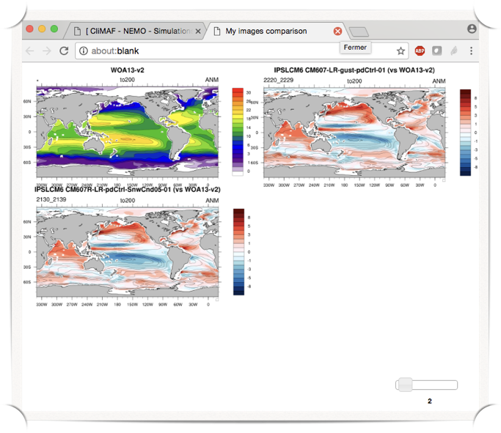
CliMAF
Atlas Explorer — The ‘compareCompanion’
Display a selection of figures on the fly:
Here is your selection of plots!
Control the number of columns with the slider.
And switch their positions by dragging the image you want at the position of your choice

Slide 27
CliMAF
Contributions
The CliMAF Earth System Model Evaluation Platform, 2017
J. Servonnat, S. Sénési, L. Vignon, O. Marti, P. Brockmann, S. Denvil
Contributors:
F. Hourdin, I. Musat, M.P. Moine, E. Sanchez, M. Chevallier, R. Msadek, J. Deshayes, M. Van Coppenolle, C. Rousset, J. Mignot, J. Ghattas, P. Peylin, N. Vuichard, P. Cadule, A. Ducharne, F. Maignan, R. Séférian
Beta-testers:
O. Marti, J. Mignot, J. Deshayes, P. Braconnot, P. Sepulchre, M. Kageyama, S. Denvil, R. Séférian, A. Cozic
The authors would like to give special credit to A. Voldoire for showing the way for CliMAF, and to F. Hourdin and the LMDz team for the structure of the C-ESM-EP that is largely inspired from the LMDz evaluation atlas.
Questions: jerome.servonnat@lsce.ipsl.fr

Slide 28
ESMValTool
Introduction
Community diagnostics and performance metrics tool for the evaluation of Earth System Models (ESMs) that allows for routine comparison of single or multiple models, either against predecessor versions or against observations.
Allows quick looks at standard diagnostic plots and output diagnostic variables
Allows to compare models participating in CMIP and CMIP6-Endorsed MIPs.
Useful for model groups and those analysing models
Useful for model development
Community development allows for multiple developers from different institutions to contribute and join
More than 60 developers from 20 institutions lead by DLR (ESMValTool, Eyring et al., 2016a)
First version is available on GitHub: https://github.com/ESMValGroup/ESMValTool

Slide 29
ESMValTool
Introduction
ESMValTool can be used as one of the documentation functions in CMIP to help understand the origins and consequences of model errors. The goal of this aspiration is to develop a benchmarking and evaluation tool that produces well-established analyses as soon as model results become available on the ESGF. This is realised through standard namelists that reproduce a certain set of diagnostics and performance metrics that have demonstrated its importance in benchmarking ESMs in a previous papers or assessment reports.
The expectation is that in this way the routine and systematic evaluation of model results could be made more efficient, thereby enabling scientists to focus on developing more innovative methods of analysis. The goal is to run tool on model output of CMIP6 alongside ESGF.
The ESMValTool utilises obs4MIPs, ana4MIPs, ESACCI plus additionally available observations to evaluate the models. In many diagnostics and metrics, more than one observational dataset or meteorological reanalysis is used.

Slide 30
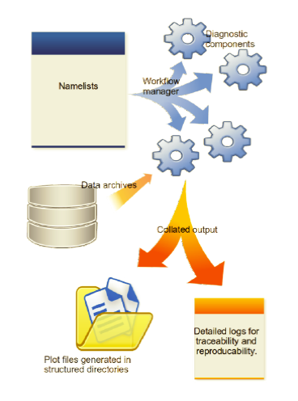
ESMValTool
Overview
Eyring et al., 2015
The workflow manager (Python script main.py) runs a set of diagnostics on data provided by IPSL local ESGF archive. The configuration and the settings of each diagnostic are specified in namelists. The results which typically comprise of NetCDF files and/or plots are stored in output folders along with log-files summarising the data used, references, and technical details to ensure traceability and reproducibility of the results.

Slide 31
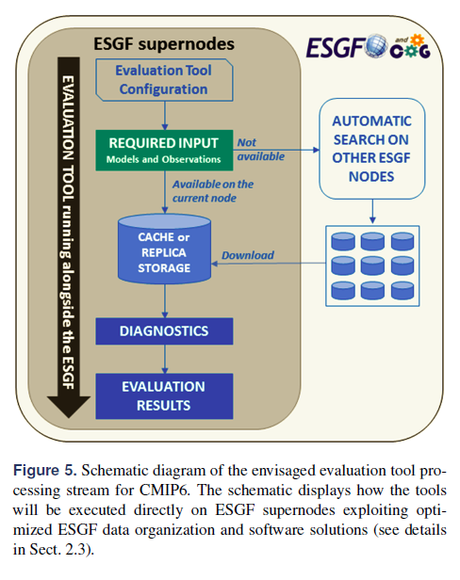
ESMValTool
Evolution
Current status, on CICLAD:
Under development (Eyring et al., 2016):
No automatic search: at every institute users have to prescribe local data DRS through local Python classes…
If the model results are not available – the request should be made to IPSL ESGF data manager to replicate the data
Code mainly based on NCL programming language (but with multi-language support for diagnostics: R, Python, NCL…)
Still contains some ‘hard-coded’ parts
Backend code is migrating to Python

Slide 32
ESMValTool
Available diagnostics
Aerosol Diagnostics
Cloud Diagnostics
Cloud Regime Error Metric (CREM)
Diurnal Cycle of Convection
Emergent Constraints on Carbon Cycle Feedbacks
Evapotranspiration, global climatology
IPCC AR5 Chapter 9
Land and Ocean components of the carbon cycle
NCAR's Climate Variability Diagnostics Package (CVDP)
Performance Metrics for Essential Climate Parameters
South Asian Summer Monsoon Diagnostics
SeaIce Diagnostics
Southern Hemisphere
Standardised Precipitation Index diagnostics
Tropical Variability
West African Monsoon Diagnostics
And others, see detailed manual here: https://github.com/ESMValGroup/ESMValTool/blob/master/doc/ESMValTool_Users_Guide.pdf
Some diagnostics are hardcoded and need further work for adaptation.
Also not all the observations are available yet.
The work is ongoing.

Slide 33
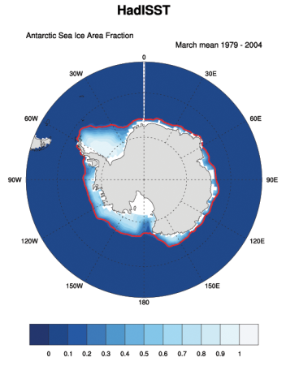
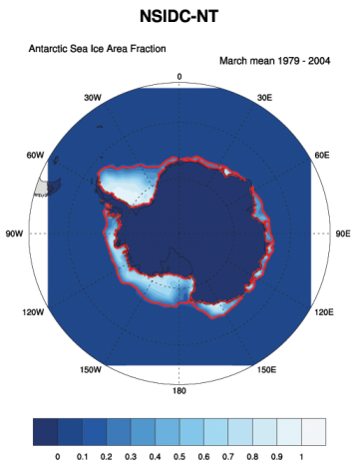
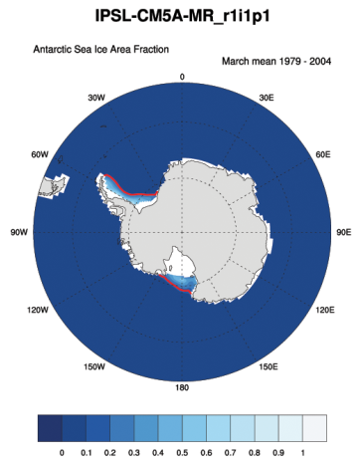
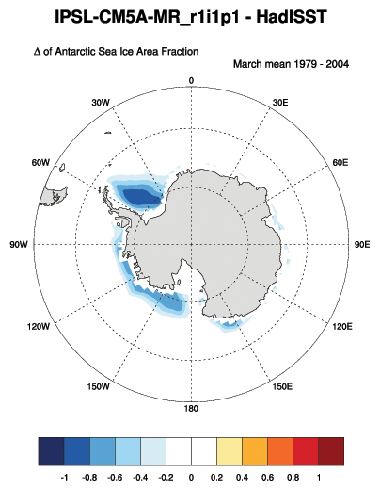
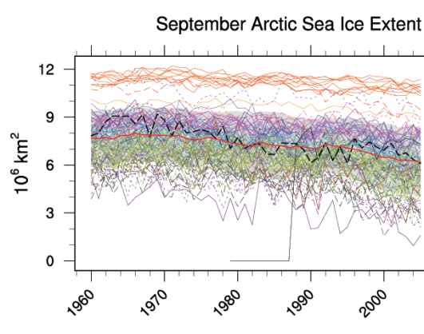
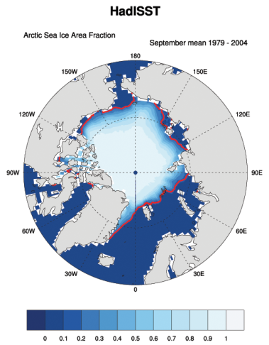
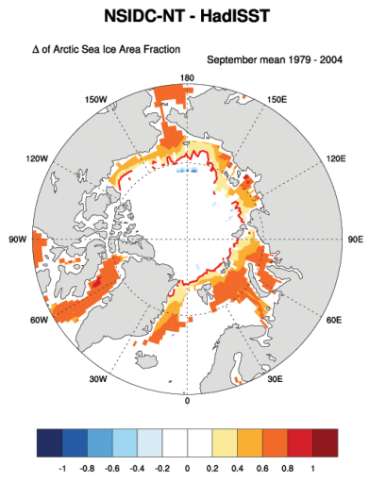
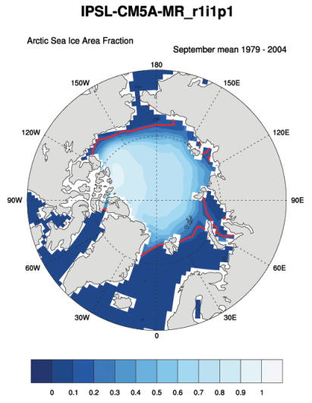
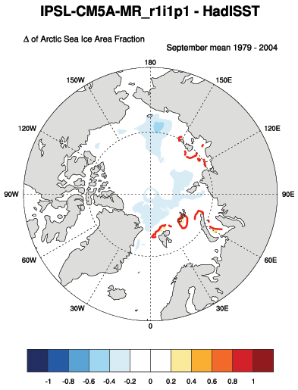
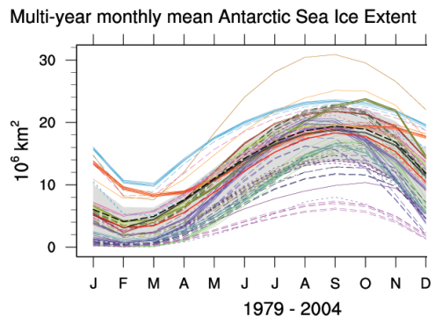
ESMValTool
Example of diagnostics results: Sea Ice

Slide 34
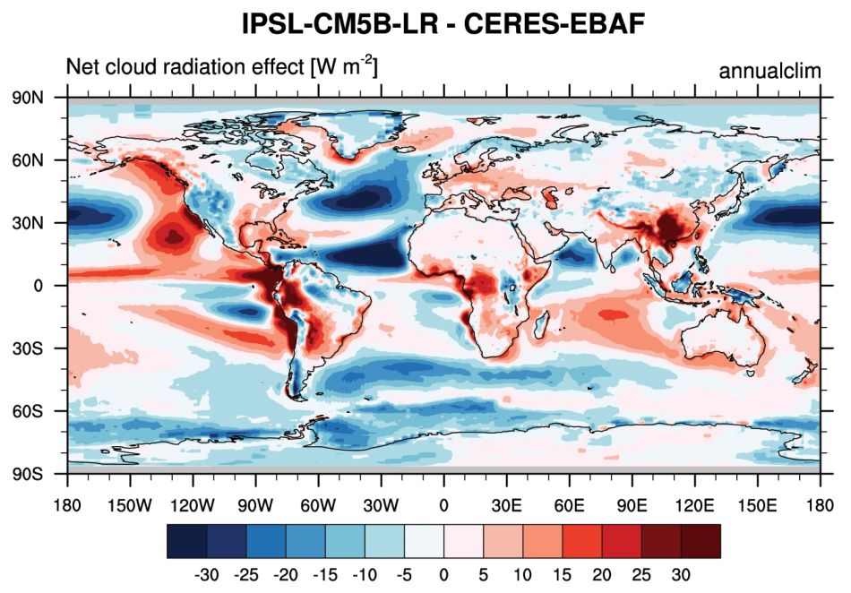
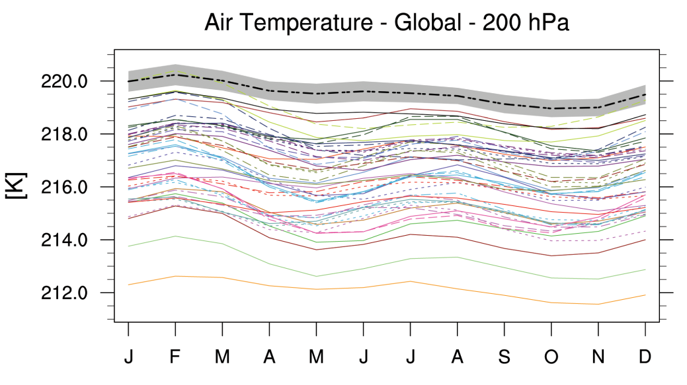
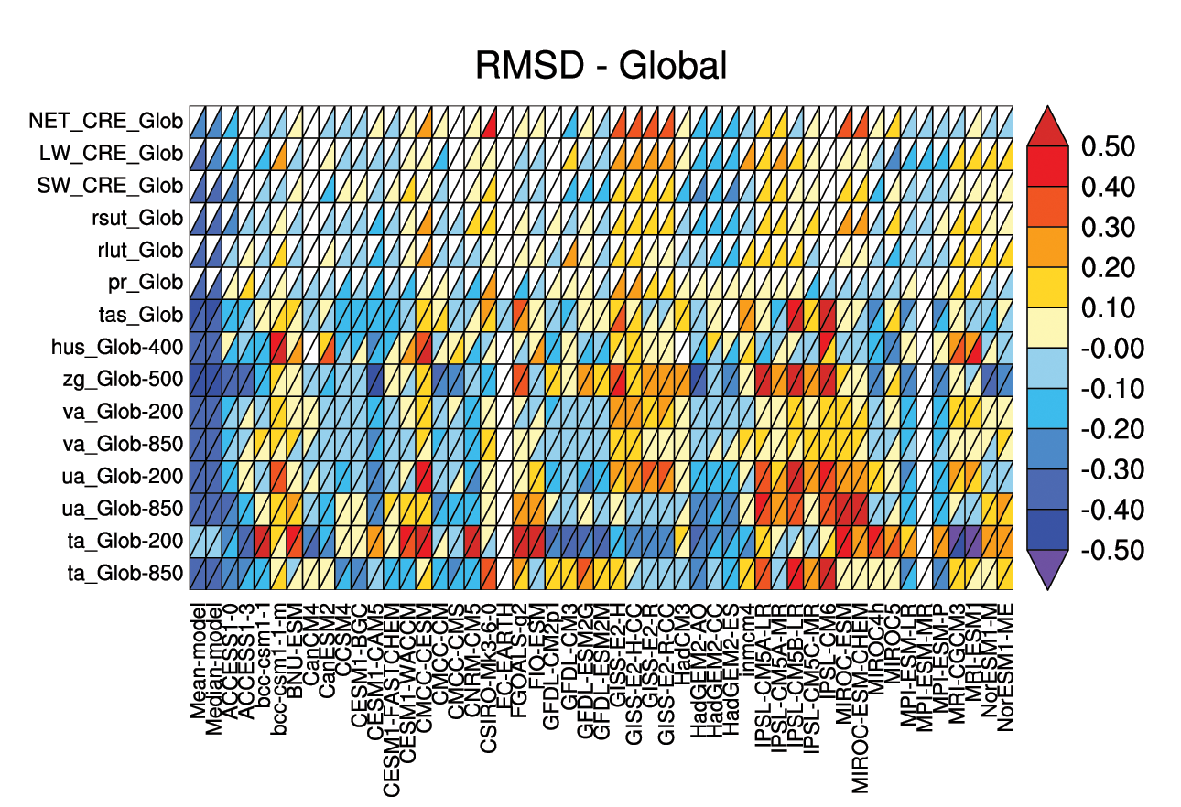
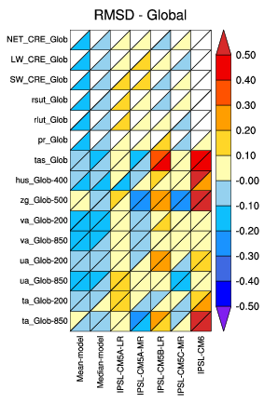
ESMValTool
Performance metrics

Slide 35
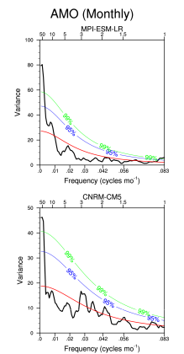
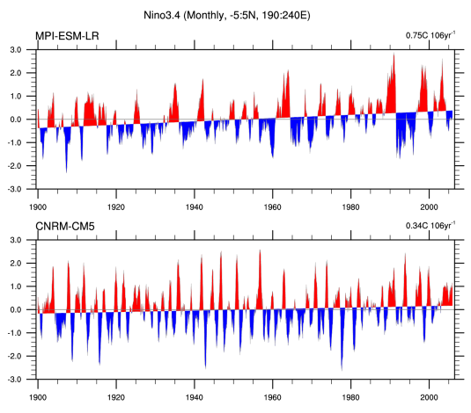
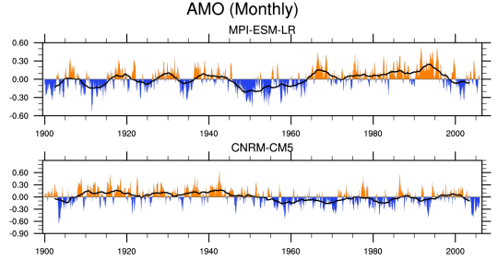
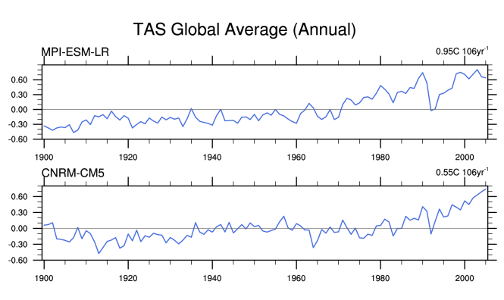
ESMValTool
HTML output

Slide 36
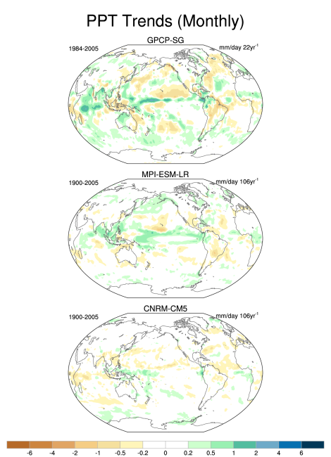
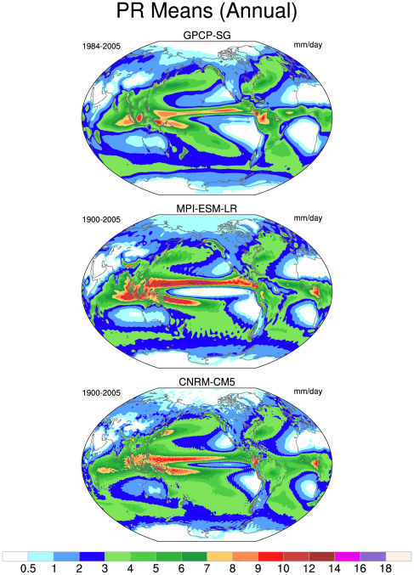
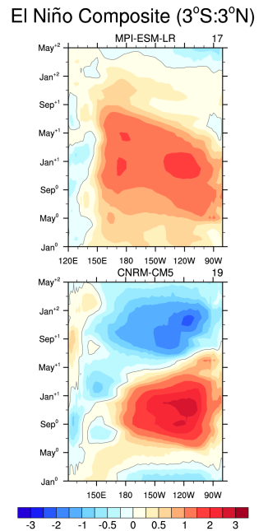
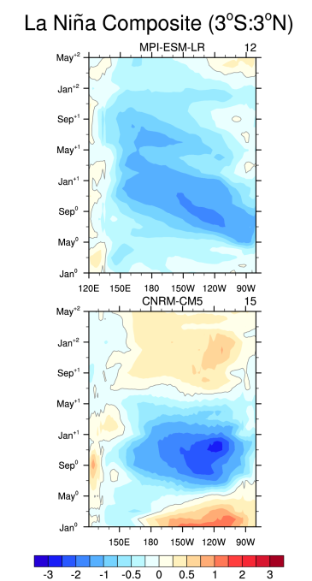
ESMValTool
HTML output

Slide 37
ESMValTool
Operational support on LMDZ model evaluation

